Slide 1
Take Home Exam
Smart Manufacturing For Pharmaceutical Industries
Notes:
Copyright by John Wiley and Sons, 2006

Slide 2
Contents
Introduction
ER Diagram
Queries Explanation
Notes:
Copyright by John Wiley and Sons, 2006

Slide 3
Introduction
Smart manufacturing transforms traditional factories from cost centers into profit centers helping business in investing strategically.
In this mini project, sensors are kept on every machinery to monitor liquid level, heat level, chemical composition , mixing speed rate and any kinds of failure that occur in machinery.
The continuous monitoring of machinery by sensors will help pharmaceutical industry to improve worker safety and protect the environment by making zero emissions, zero-incident manufacturing possible
Notes:
Copyright by John Wiley and Sons, 2006

Slide 4
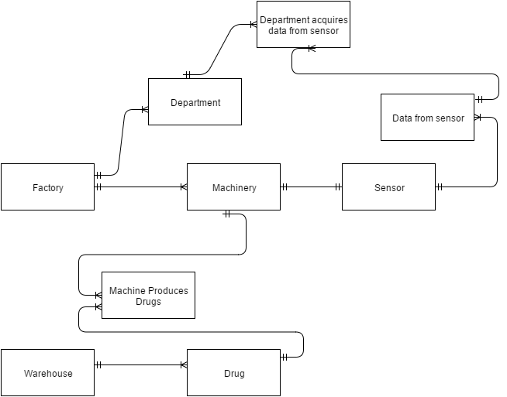
ER Diagram
Notes:
Copyright by John Wiley and Sons, 2006

Slide 5
ER Explanation
For one enterprise like Pfizer, there will be many factories all over the world. In this mini project, I am taking one enterprise and one enterprise has many factories.
A factory will have many machineries and on every machinery there will be one sensor.
A factory will have many departments and data collected from sensor will be viewed by department.
The specific data from sensor will be viewed by one department. For example, liquid level and heat level will be viewed by mechanical department and chemical composition will be viewed by chemical department.
1 Machine will produce many drugs and one drug can be produced by many machineries so drug and machine have m-m relationship, thus associative entity is created between machine and drug namely machine produces drug.
One batch of drug will be kept in one warehouse and one warehouse can have many batches of drugs.
Notes:
Copyright by John Wiley and Sons, 2006

Slide 6
Query Explanation
SET 1 and 2:
Create DB, creates tables, create sample records/values/tuples, USE, and Drop DB
Use DB, create tables with table options (NULL, Key, etc.), data types, insert, index and set
Notes:
Copyright by John Wiley and Sons, 2006

Slide 7
Set 1 & 2 Query
The tables namely factory, machinery, sensor, data from sensor, warehouse, drug, machineProducesDrugs, department and departmentAcquiresDataFromSensor are created using CREATE statement.
In table factory, factoryID is primary key. Identity(1,1) is used which will start factoryID from 1 and increment it by 1 every time new row is added.
In Machinery table, machineryID is primary key and machineryID will start from 100 and incremented by 1 every time new row is added. As one factory will have many machineries so machinery will have factoryID as foreign key that will refer to factoryID of factory.
Table sensor will have primary key as sensor ID and one sensor will be on one machinery so table sensor will have machinery ID as foreign key that will refer to machinery ID of machinery.
Table DataFromSensor will have sensorID and timestamps as composite primary key because sensor will be sending data in every 1 minute so sensorID and timestamp will form a unique combination.
Notes:
Copyright by John Wiley and Sons, 2006

Slide 8
Set 1 & 2
The table datafromsensor will have sensorID as foreign key that will refer to sensorID of sensor.
Table warehouse will have warehouseID as primary key and as one factory has many warehouses so factoryID in warehouse will be foreign key and refer to factoryID of table factory.
Table drug will have batch Number as primary key and one warehouse has many drugs so warehouseID will be foreign key and refer to warhouseID of table warehouse.
The table machine produces drugs is an associative table that contains primary key (batch number, machineryID) and batch number is foreign key to batch number of drug and machinery ID is foreign key to machineryID of machinery
Table departmentacquiresDatafromsensor will have primary key as sensorID, departmentID and timestamps. Whenever any attribute like heat level, liquid level will cross set range then data in this table will be triggered.
Notes:
Copyright by John Wiley and Sons, 2006

Slide 9

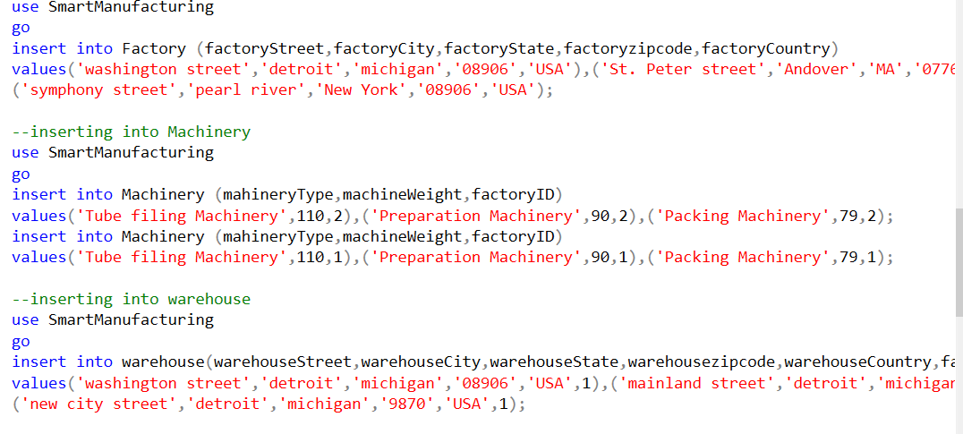
SET 1 & 2
The unique index is set on table datafromsensor that will take only unique values of sensorId + timestamps.
Values are inserted in these tables using INSERT statement.
Notes:
Copyright by John Wiley and Sons, 2006

Slide 10
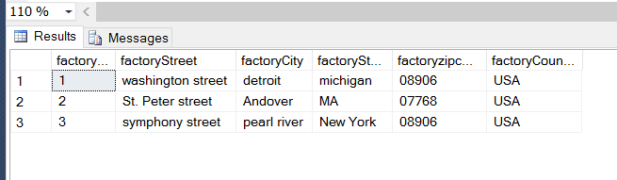
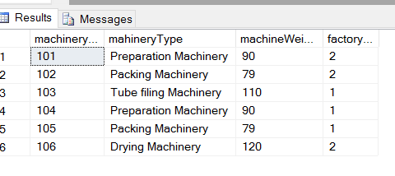
Set 1 & 2
The values in factory table after insert:
The values in machinery table after insert:
Notes:
Copyright by John Wiley and Sons, 2006

Slide 11
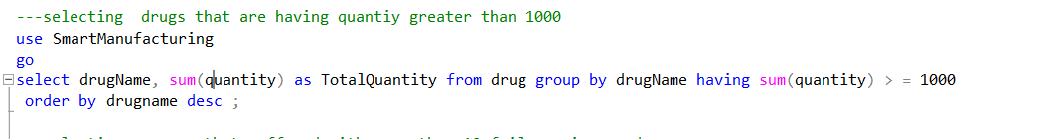
SET 3 & 4
Set 3: Select – From – Where – Group By – Having - Order By – Limit
The above query will select all the drugs that are having quantity greater than 1000. The function sum(quantity) will calculate quantity of every drug present in drug table and if quantity is greater than 1000 then that drug will be selected. For checking condition having clause is used and the drugs will be displayed in descending order using keyword desc. Here the function sum and comparison operator has been used.
Notes:
Copyright by John Wiley and Sons, 2006

Slide 12
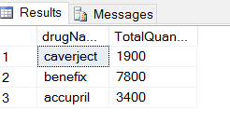
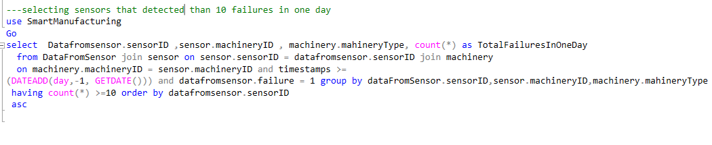
SET 3 & 4
The output is shown below:
Below query will select those sensors that detected more than 10 failures in a machine in one day.
Notes:
Copyright by John Wiley and Sons, 2006

Slide 13
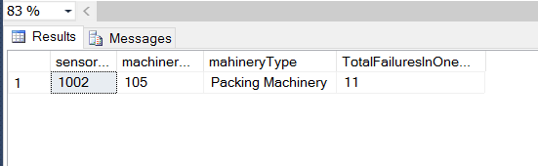
SET 3 & 4
Previous query will count the number of failures of every sensor by checking failure = 1 (failure occurred) and it will count the rows by using count(*) that are having failure = 1 and if count(*) > = 10 then that that sensor, its machinery type and id will be displayed with total count of failure. The DATEADD(day,-1, GETDATE()) will check only those sensors that have timestamps of yesterday.
Here in this query dateadd, getdate, count(*) functions are used.
Notes:
Copyright by John Wiley and Sons, 2006

Slide 14
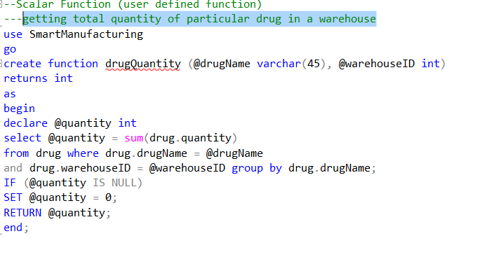
SET 4
User defined Functions or scalar function: The function drugQuantity is created to get total quantity of particular drug in a warehouse.
Notes:
Copyright by John Wiley and Sons, 2006

Slide 15
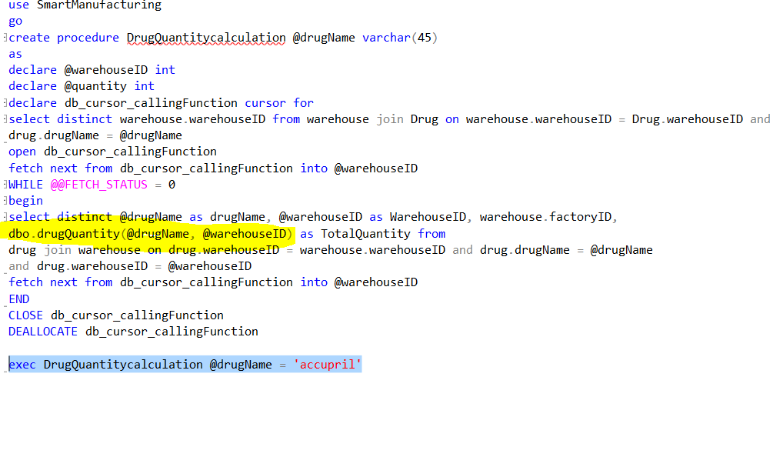
SET 4
The previous scalar function have two input parameters drug Name and warehouse ID. It is taking a particular drug whose total quantity needs to be find in a particular warehouse. This function is called in a procedure as shown below:
Notes:
Copyright by John Wiley and Sons, 2006

Slide 16
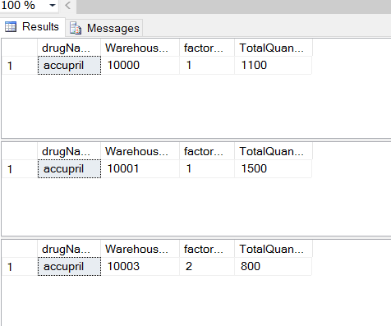
SET 4
The above procedure will take drug name as input. Here cursor is used to select all those warehouses where this particular type of drug is present and for all these warehouses , quantity of this drug is calculated using function.Cursor creates a temporary table and retrieves each row from that table.
The output is shown below:
Notes:
Copyright by John Wiley and Sons, 2006

Slide 17
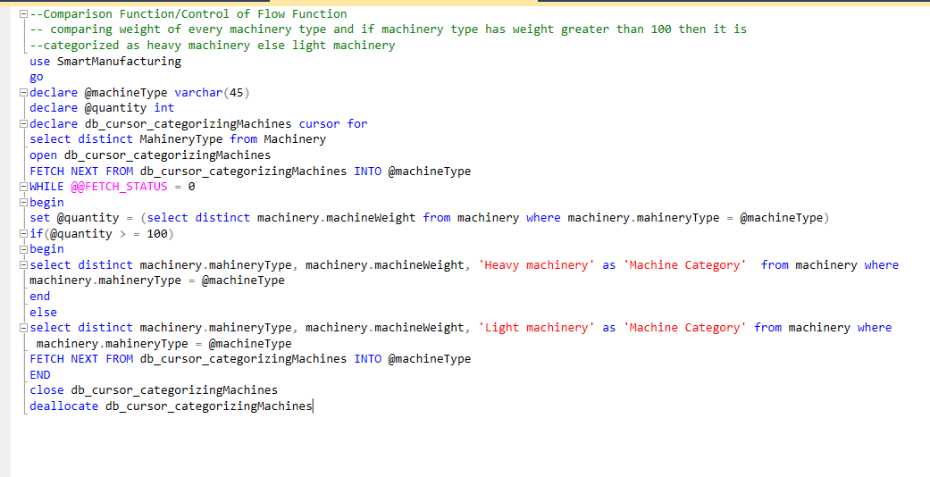
SET 4(Comparison Function/Control of Flow Function
)
In the below query, checking weight of every machinery type and if machinery type has weight greater than 100 then it is categorized as heavy machinery else light machinery
Notes:
Copyright by John Wiley and Sons, 2006

Slide 18
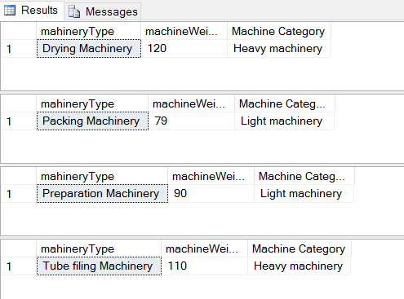
SET 4
The previous query is selecting machinery Type from machinery using cursor. For every machinery type checking its weight. If weight is greater than 100 then it is categorized as heavy machinery else it is categorized as light machinery. Here if, else , begin , end statements are used.
Notes:
Copyright by John Wiley and Sons, 2006

Slide 19
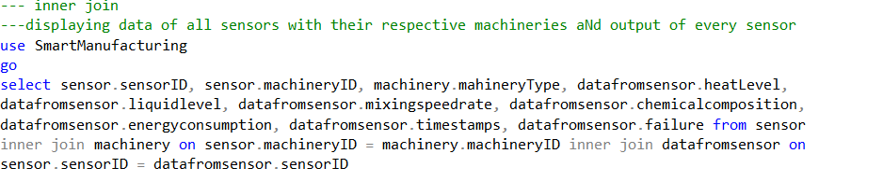
SET 5(INNER JOIN)
Inner join is used for displaying data of all sensors with their respective machineries. This join will display sensor details , machinery details and data produced by sensor for machinery on which it has been fixed. Inner join will select those rows where conditions are matching
The output has been shown in next slide:
Notes:
Copyright by John Wiley and Sons, 2006

Slide 20
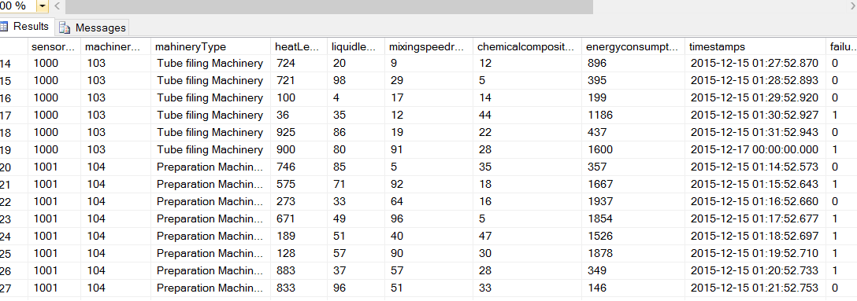
SET 5
Notes:
Copyright by John Wiley and Sons, 2006

Slide 21
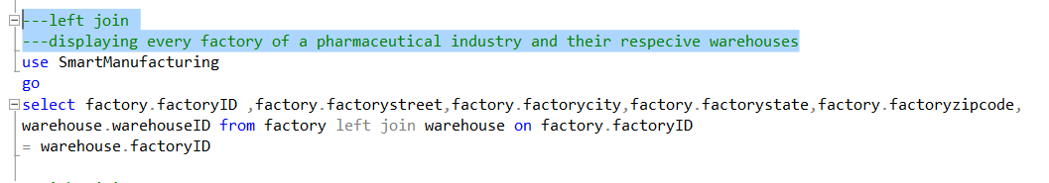
SET 5(LEFT JOIN)
Left join will display all the values from the left table irrespective and matched rows from right table.
left join is displaying every factory of a pharmaceutical industry and their respective warehouses.
The above query will select all the factories and will display their warehouses. If factory does not have a warehouse then null will come in warehouse field.
Notes:
Copyright by John Wiley and Sons, 2006

Slide 22
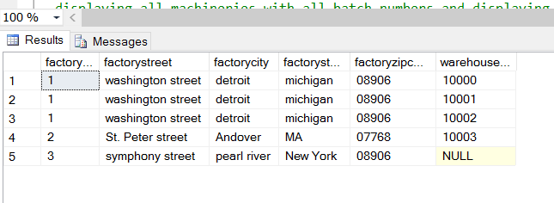
SET 5 (LEFT JOIN)
Notes:
Copyright by John Wiley and Sons, 2006

Slide 23
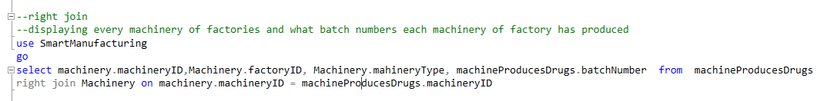
SET 5 (RIGHT JOIN)
Right join will display all the values from right table and matching values from left table.
The query will display all machineries and their batch numbers. If machinery has not produced any batch number then column value will be null.
The result is shown in next slide:
Notes:
Copyright by John Wiley and Sons, 2006

Slide 24
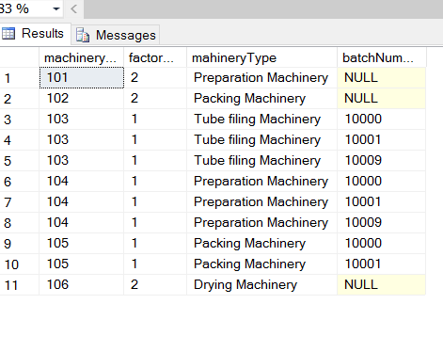
SET 5
Notes:
Copyright by John Wiley and Sons, 2006

Slide 25
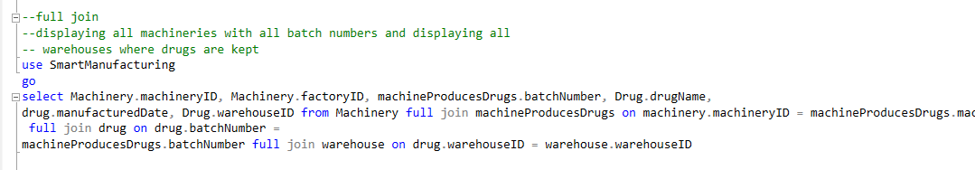
Set 5(full join)
Full join is used to display all rows from both the tables
full join is used to display all machineries with all batch numbers and displaying all warehouses where drugs are kept .
Notes:
Copyright by John Wiley and Sons, 2006

Slide 26
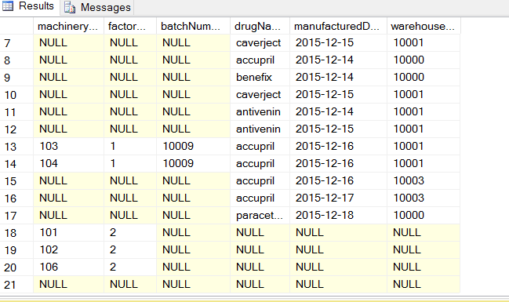
Set 5(Full join)
Notes:
Copyright by John Wiley and Sons, 2006

Slide 27
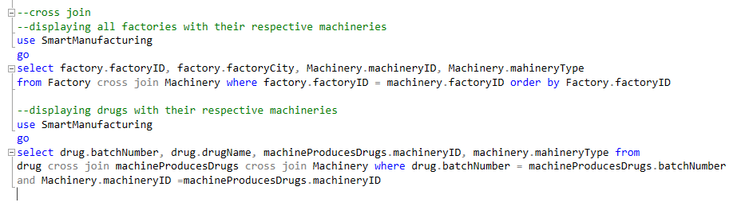
SET 5(CROSS JOIN)
Cross join is used to get Cartesian product of two tables.
First query on cross join query is used to display all factories with their respective machineries
Second cross join query is used to display drugs with their respective machineries.
Notes:
Copyright by John Wiley and Sons, 2006

Slide 28
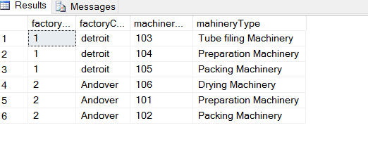
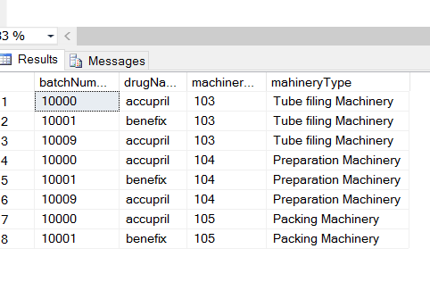
SET 5(CROSS JOIN)
Output of first cross join:
Output of second cross join:
Notes:
Copyright by John Wiley and Sons, 2006

Slide 29
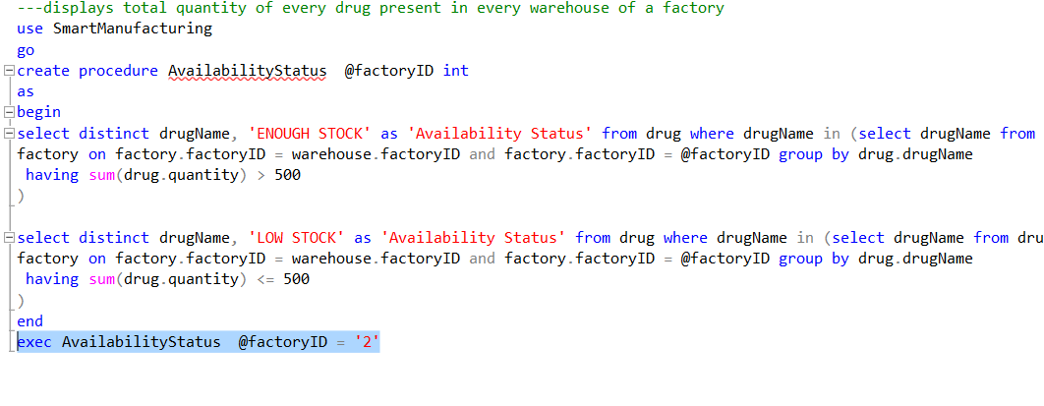
SET 6(Subquery)
Subquery is query within query. In my application, I have used subquery to check the availability of every drug in every warehouse of a particular factory. If quantity is greater than 500 then it will show enough stock else low stock.
The query is written below:

Slide 30
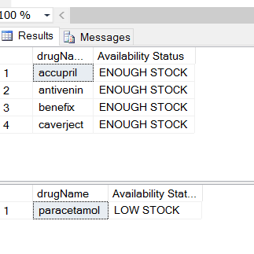
Set 6(Subquery)
Output is:

Slide 31
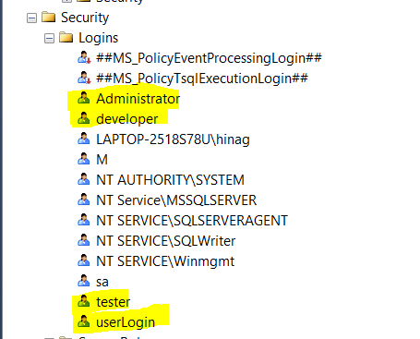
SET 7(user privileges)
Four users are created namely:
Developer
Tester
Admin
User
Notes:
Copyright by John Wiley and Sons, 2006

Slide 32
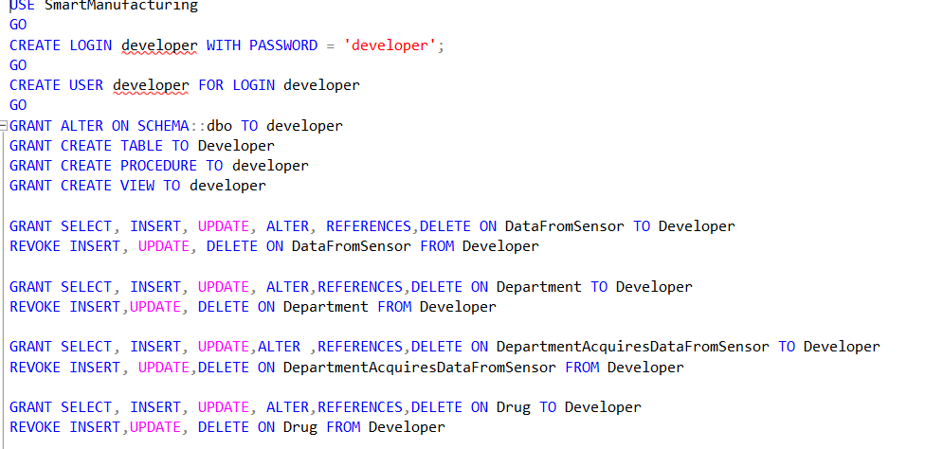
SET 7(user privileges)
The developer has been given privileges for create on table, create procedure, create view , references, select on all tables. The references has been used to create foreign key constraint. The developer has been given grant to alter schema so that he could create tables.
Developer has not been given privilege for update, insert and delete on all tables
Notes:
Copyright by John Wiley and Sons, 2006

Slide 33
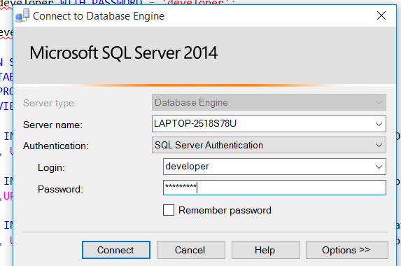
SET 7(user privileges)
When developer logins:
Notes:
Copyright by John Wiley and Sons, 2006

Slide 34
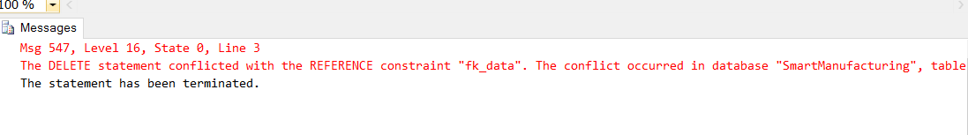
SET 7(user privileges)
When developer logins and delete any row then the below error will be given:
Notes:
Copyright by John Wiley and Sons, 2006

Slide 35
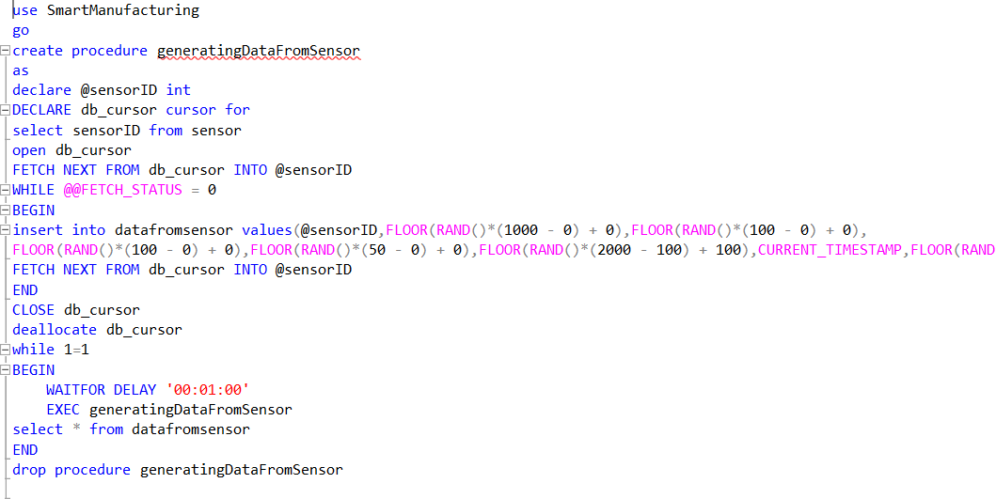
SET 8(Stored Procedure)
Stored Procedure “generatingDataFromSensor “ is called to generate data randomly for table datafromsensor. It is done to simulate the case where sensor is producing data after every 1 minute.This stored procedure will run infinitely using while loop.
Notes:
Copyright by John Wiley and Sons, 2006

Slide 36
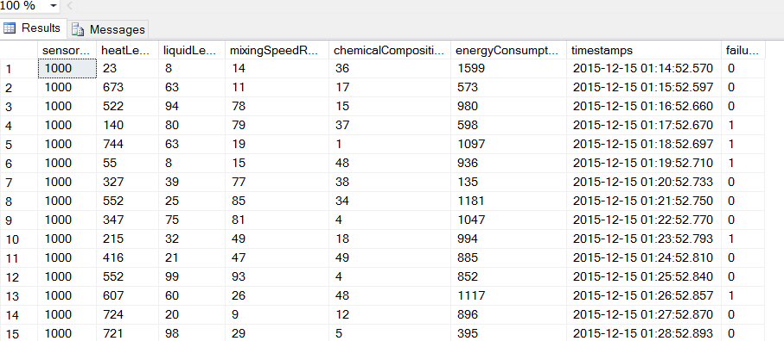
SET 8(Stored Procedure)
The procedure in previous slide will use cursor to select all sensor ID and then inserting data into datafromsensor by using random function and generating values for heat level, liquid level, chemical composition, energy consumption etc.
Notes:
Copyright by John Wiley and Sons, 2006

Slide 37
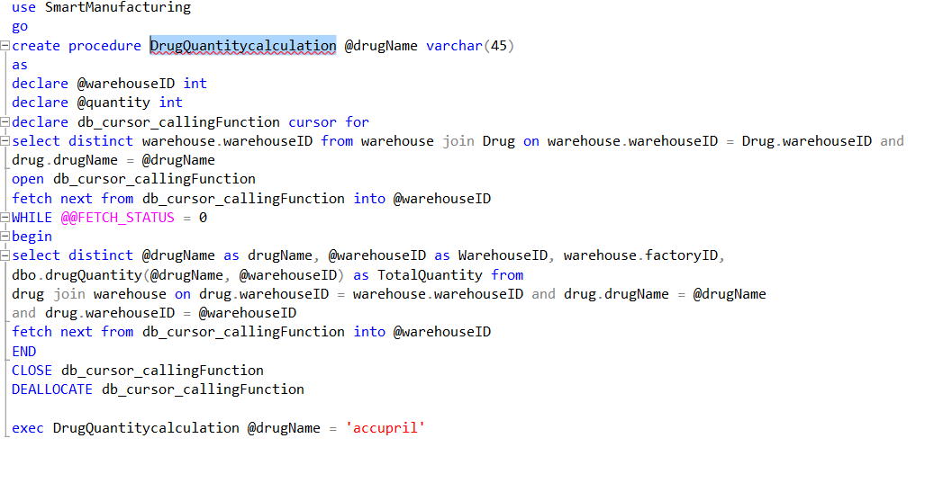
SET 8
The procedure “ DrugQuantitycalculation” is used to calculate drug quantity in every warehouse where that drug is present. This procedure will take drug name as input. Here cursor is used to select all those warehouses where this particular type of drug is present and for all these warehouses , quantity of this drug is calculated using function. Here user defined function drugQuantity is used to calculate total quantity of drug in that warehouse.
Notes:
Copyright by John Wiley and Sons, 2006

Slide 38
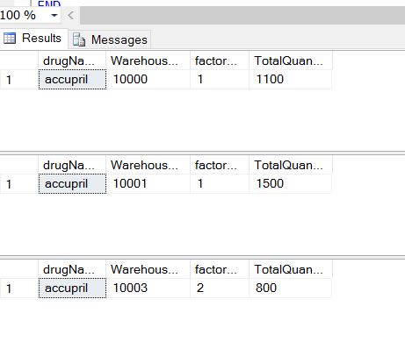
SET 8(Stored Procedure)
Output of procedure:
Notes:
Copyright by John Wiley and Sons, 2006

Slide 39
SET 9(Transactions)
Transaction: is used to perform sequence of actions.
Commit will commit all the changes made in the transaction
Rollback will rollback all the changes done in the transaction
Savepoint : if changes are roll back then changes will rollback till the savepoint.
Notes:
Copyright by John Wiley and Sons, 2006

Slide 40
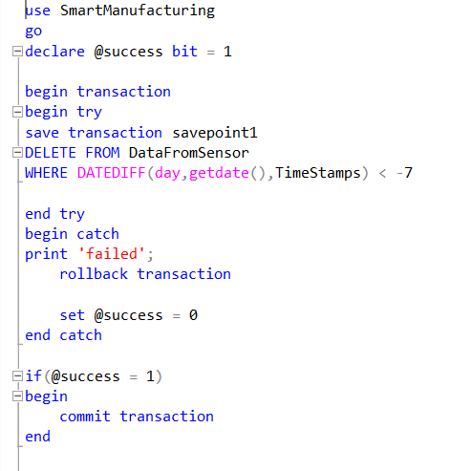
SET 9(Transactions)
Data from sensor is coming after every 1 minute so datafromsensor will have lot of entries. In order to maintain database efficiency, the data that is 1 week older will be deleted. For this rollback and commit has been used. If data deletion occurred with errors then the transaction will rollback till the savepoint. The savepoint is created where the delete statement is used to delete the older data.
Notes:
Copyright by John Wiley and Sons, 2006

Slide 41
SET 10(Triggers)
Trigger when inserted
This trigger is used when we want to do some changes when insert happens on any table
In my application, a trigger is created on table datafromsensor . Whenever any value like liquid level, heat level, energy consumption, chemical composition, mixingspeedrate will cross the normal value then that row will be inserted into the table departmentacquiresdatafromsensor where the heat level, liquid level will be seen by mechanical deparment only, chemical composition and mixingspeedrate will be seen by chemical department and energy consumption will be seen by electrical department and controller department can see all the values.
Notes:
Copyright by John Wiley and Sons, 2006

Slide 42
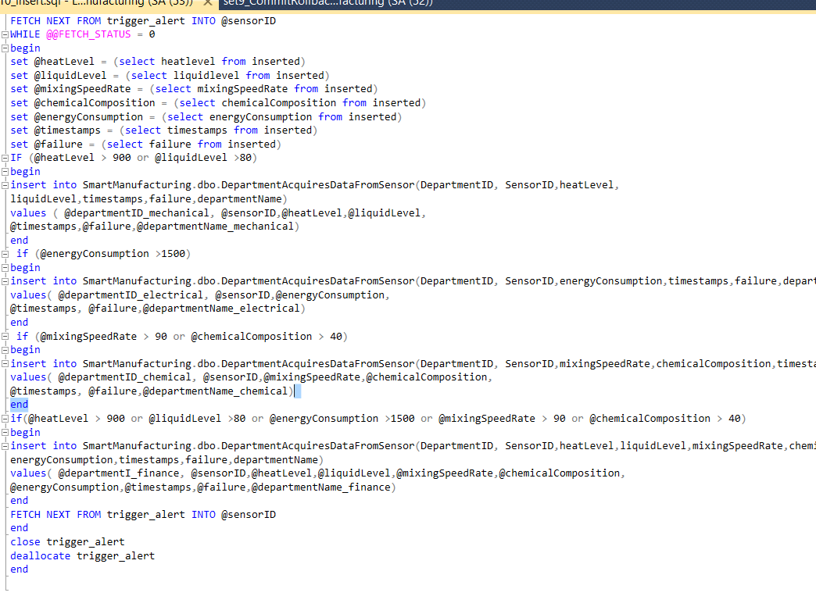
Set 10(Triggers)
Query of insert trigger:
Notes:
Copyright by John Wiley and Sons, 2006

Slide 43
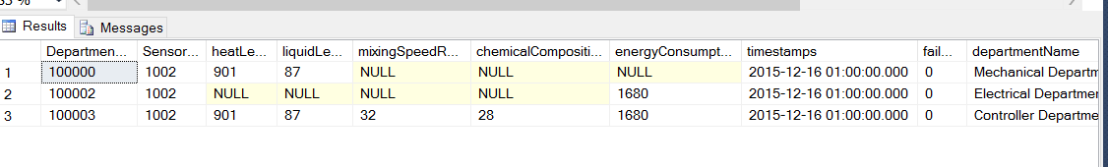
Set 10(Triggers)
Output:
In above output, we can see that department ‘mechanical department’ can see the values of exceeding heat and liquid level and failure values while all other values are null.
Electrical department can view only exceeding energy consumption value.
Similarly, controller department can view all the exceeding values.
Notes:
Copyright by John Wiley and Sons, 2006

Slide 44
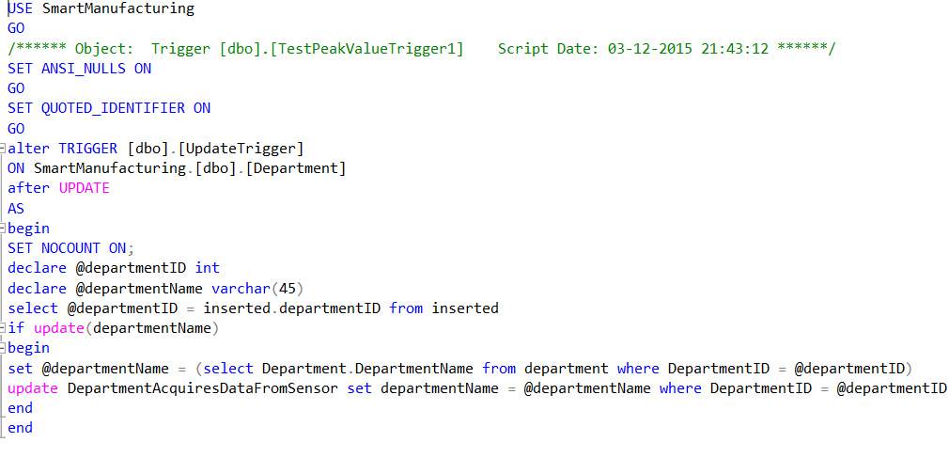
Set 10(Triggers)
Trigger when updated:
This trigger is used when we want to have some changes on update on any table.
In my application, whenever department name is updated in department table then the department name should be updated in departmentacquiresdatafromsensor.
Notes:
Copyright by John Wiley and Sons, 2006

Slide 45
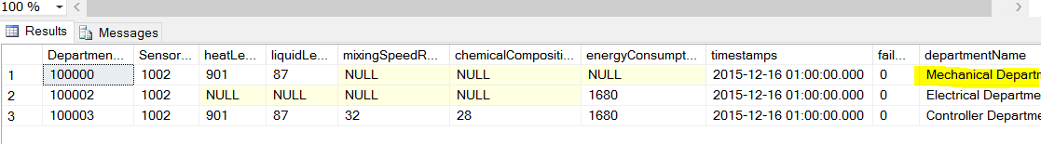

Set 10(Triggers)
The department name for department ID 100000 is mechanical department
After updating department name in department table the trigger on update will be called and the department name will change for departmentacquiresdatafromsensor

Slide 46
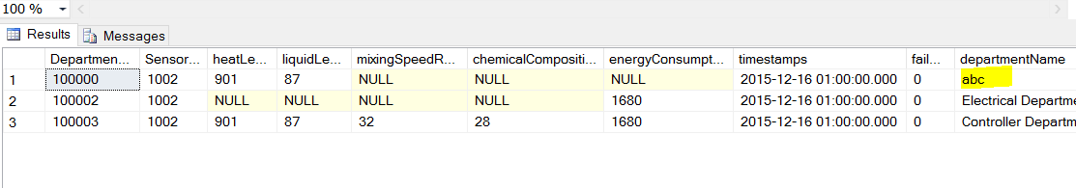
Set 10(Triggers)
After trigger on update

Slide 47
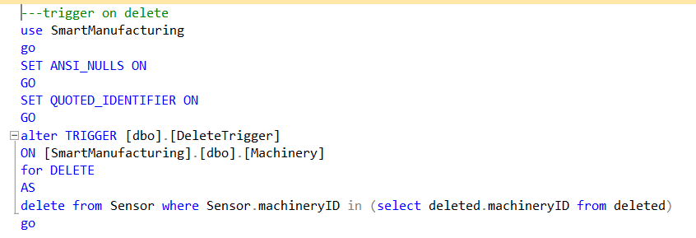
Set 10(Triggers)
Trigger on delete
Delete trigger is used when any delete occurs in a table.
In my application, I have used delete trigger when a machinery is deleted from machinery table then the sensor attached on the machinery should be deleted automatically using trigger.

Slide 48
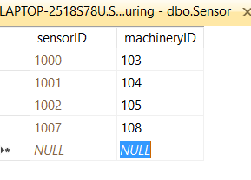

Set 10(triggers)
There is a sensor for machinery 108 as shown below:
After deleting this machinery 108 , the sensor 1007 will be deleted automatically using trigger.

Slide 49
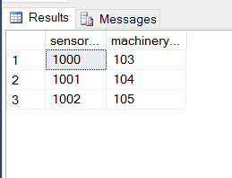
SET 10(Triggers)
The output after deleting machinery:

Slide 50
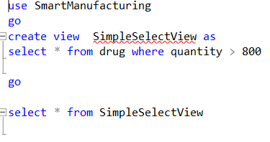
Set 11 (views and backup)
Views are tables that contains attributes from many other tables. If a user wants to frequently see data that comes from joins of various tables then a view should be created to avoid use of joins again and again.
In my application I have created view where I have created a simple view where the drugs are selected from drug table that has quantity greater than 800

Slide 51
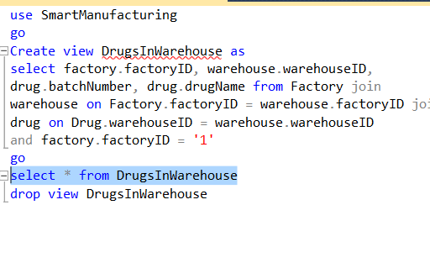
Set 11 (Views and Backups)
The second view is created to view details of factory Id = 1 like warehouse number, batch number and drug name.

Slide 52
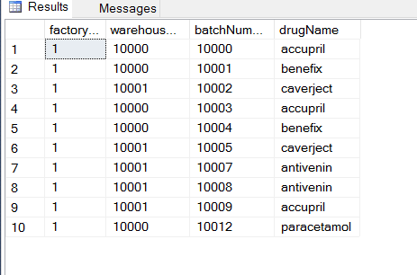
Set 11 (Views and Backup)
Output:

Slide 53
Set 11 (views and Backups)
The third view is created for every department, so that that department could view the data present in departmentacquiresdatafromsensor . This table contains crucial data as whenever any attribute crosses the range then the value will be added to this table. Hence department will view this crucial data. For every department if department id is present in departmentacquiresdatafromsensor then the view for that department will be created.
The query is shown in next slide.

Slide 54
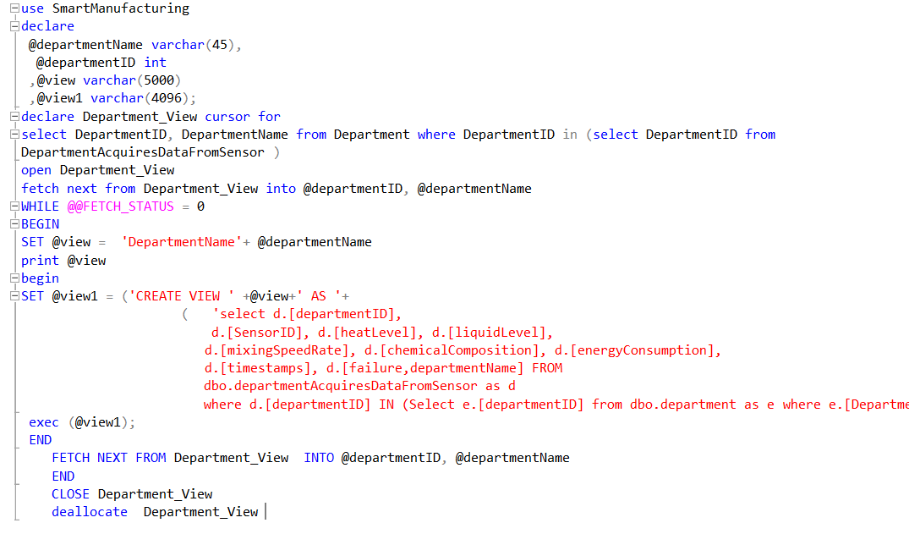
Set 11 (views and backup)

Slide 55
Set 11 (Backups)
Backups are taken to avoid loss of data. Backups are scheduled so that backups are taken frequently
In my application, I will be taking full backup every Sunday and differential backup everyday.
Differential backup backs up data from the last full backup.
As our database contains critical data for the business so differential backup is preferable than incremental backup.

Slide 56
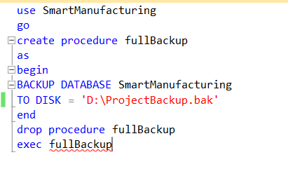
Set11 (Backup)
Query for full backup

Slide 57
Set 11 (Backup)
Output of full backup:

Slide 58
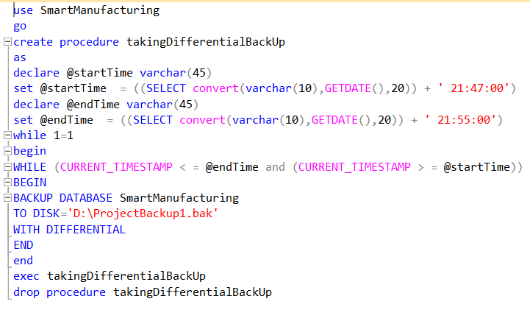
SET 11 (Backup)
Differential backup query

Slide 59
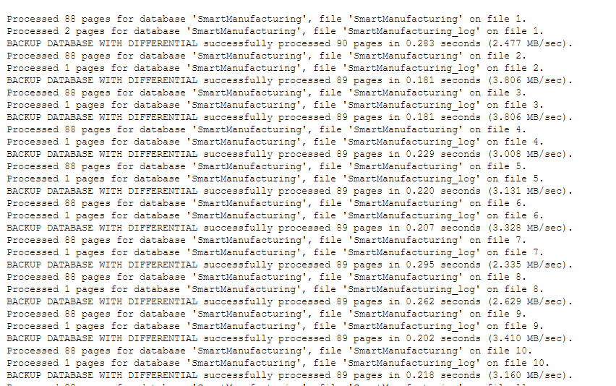
Set 11(Backup)
Output of differential backup

Slide 60
Thank you

